Slide 1

Walmart Retail Demand Forecasting
Predicting weekly sales at the store-department level using machine learning
Puja Patidar
Feb 2026

Slide 2
The Forecasting Challenge
Problem Statement
Project Objective
Accurate demand forecasting is critical for retail operations
Poor forecasts cause overstocking, stockouts, and revenue loss
Store–department sales show high variability
Promotions, seasonality, and economic factors drive demand fluctuations
Build an ML model to forecast weekly store–department sales
Capture effects of promotions, seasonality, and economic factors
Identify key drivers of sales variability

Slide 3




Intended Users & Benefits
Inventory Planning
Store Operations
Optimize stock levels, prevent overstocking/stockouts.
Efficiently plan staffing and manage store-level operations.
Supply Chain & Logistics
Merchandising & Category
Plan shipments, warehouse capacity, and distribution schedules.
Assess impact of promotions, seasonality, and pricing on sales.

Slide 4

Data Source
Kaggle: Walmart Recruiting – Store Sales Forecasting
Final dataset: 421,570 rows × 17 features.
Target: Weekly sales (Dollar).
Includes sales, markdowns, store metadata, calendar, and external indicators.
Kaggle Dataset Link

Slide 5
Data Cleaning & Wrangling
Key Steps
Outcome
Raw datasets were merged using left join
column names standardized, and dates converted.
missing or duplicate records observed
Missing markdown values were imputed with zero
duplicate holiday columns resolved
Clean and reliable input for EDA and modelling

Slide 6
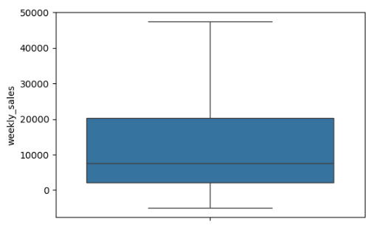
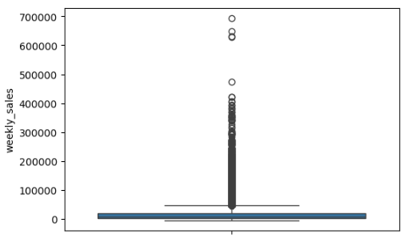
EDA Findings
Correlation of numerical features
Target variable box plot without outliers
Target variable box plot with outliers
Store size moderately impacts weekly sales
Markdown variables are highly correlated
Macroeconomic indicators show limited influence
Promotional features exhibit multicollinearity

Slide 7
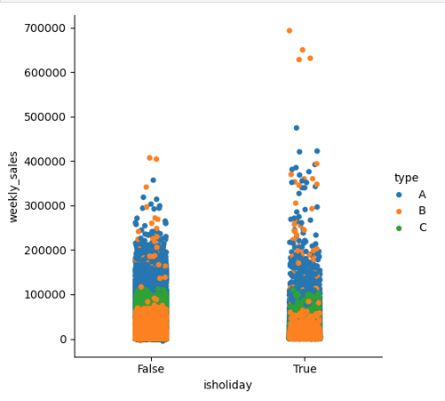
Sales Variability & Influencers
Categorical & Group Analysis
Visualization of sales
Analyzed average weekly sales across store types, revealing meaningful differences in sales performance
Compared holiday vs non-holiday weeks by store type, showing that holiday impact varies across store categories

Slide 8
Preprocessing & Modeling
01
Data Preprocessing
02
Feature Engineering
Loaded, inspected, and chronologically sorted data.
Weekly sales outliers capped at 1st and 99th percentiles to preserve temporal structure.
Derived calendar features, normalized sales by square foot, created promotion indicators, and bucketed fuel prices.
Dataset shape: (421570, 24).
03
Encoding & Baseline
04
Modeling & Evaluation
Categorical variables encoded using one-hot and target encoding
Numerical variables scaled for linear models and passed without scaling for tree-based models
Dummy Regressor used to establish a baseline performance
TimeSeriesSplit cross-validation used.
Linear, Ridge, Random Forest, and XGBoost models trained.
RMSE was primary metric.

Slide 9
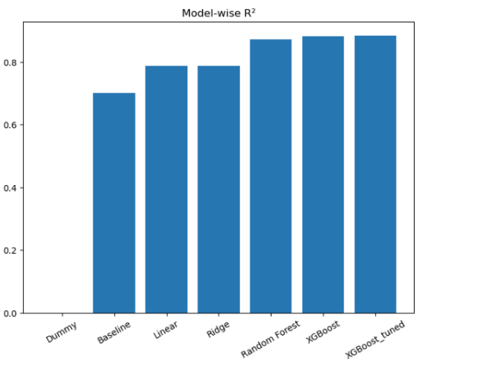
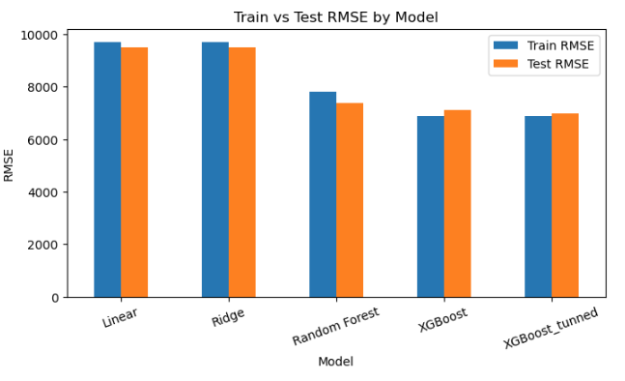
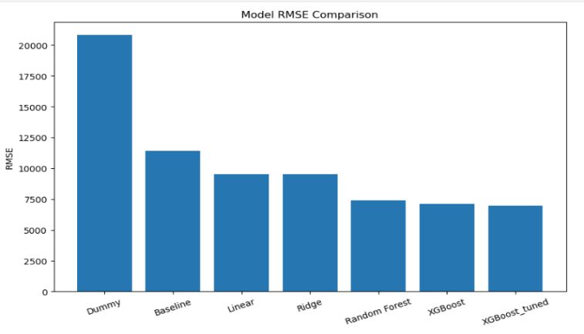
Model Performance Comparison
R2
Tran/Test
RMSE
Tuned XGBoost provides the most accurate and stable forecasts, making it the final selected model.

Slide 10
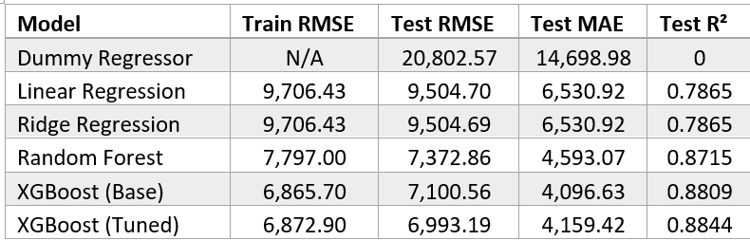
Model Performance & Conclusion
Performance
Key Findings
Tuned XGBoost achieved the lowest RMSE (6,993.19) and highest R² (0.8844), outperforming all other models
Feature importance highlighted store–department attributes, store size and type, month, and calendar effects as key sales drivers

